Slide 1

Effective Programming using “Python3”

Slide 2
Module 1 Essential Basics

Slide 3
Primary Concern of Module 1
Creating Strong Foundations in Programming
Connecting Theory with practical
Getting started with python3

Slide 4
Way to Program?
Is it better to be a multi-linguist programmer or adhere to any single language?
What should be our strategy to attack any problem?

Slide 5
How many Languages should we learn (not know)?
It is difficult to learn multiple languages
Single Language can’t solve problems of all domain
Selection of best fit programming language
Note: Go explore any language you are learning

Slide 6
General Strategy
Understand problem statement & constraints of problem to be satisfied
Develop a logical solution based on fundamental operations ! in computers
Select a suitable data structure for our algorithm (solution)
Select best fit programming language
Start Coding

Slide 7
Overview - Mod 1
Basics of Programming
History of Python
Installing & Running Python
Data types in Python

Slide 8
Basics of Programming
Understanding fundamentals
Understanding Hardware, OS & Language support

Slide 9
Fundamentals
What is program & programming language?
| Programming paradigms | ?
What is programming & what is debugging?
Syntax, Semantic & Runtime errors?
Why to follow standards & add comments?
Expressions & Statements?
Variable Declaration, Definition & Initializations?

Slide 10
Hardware, OS & Language
Von-Neumann Architecture?
High Level Language? & what differences can come when we change platform (OS) ?
Compiler v/s Interpreter ?
Improvements in modern architectures & how to exploit them?

Slide 11
Applications of Python
Shell tools
System admin tools, command line programs
Extension-language work
Rapid prototyping and development
Language-based modules
Instead of special-purpose parsers
Graphical user interfaces
Database access
Distributed programming
Internet scripting

Slide 12
Why not to use Python (and kin) for
Most scripting languages share these
Not as efficient as C
But sometimes better built-in algorithms (e.g., hashing and sorting)
Delayed error notification
Lack of profiling tools

Slide 13
Brief History of Python
Invented in the Netherlands, early 90s by Guido van Rossum
Open sourced from the beginning
Started as scripting language, but is much more
Scalable & multi-paradigm from beginning
Used by Google from the beginning
Increasingly popular

Slide 14
History of Python (contd.)
Python was conceptualized by Guido Van Rossum in the late 1980s.
Rossum published the first version of Python code (0.9.0) in February 1991 at the CWI (Centrum Wiskunde & Informatica) in the Netherlands , Amsterdam.
Python is derived from ABC programming language, which is a general-purpose programming language that had been developed at the CWI.

Slide 15

Python’s Benevolent Dictator For Life
“Python is an experiment in how much freedom program-mers need. Too much freedom and nobody can read another's code; too little and expressive-ness is endangered.”
- Guido van Rossum

Slide 16
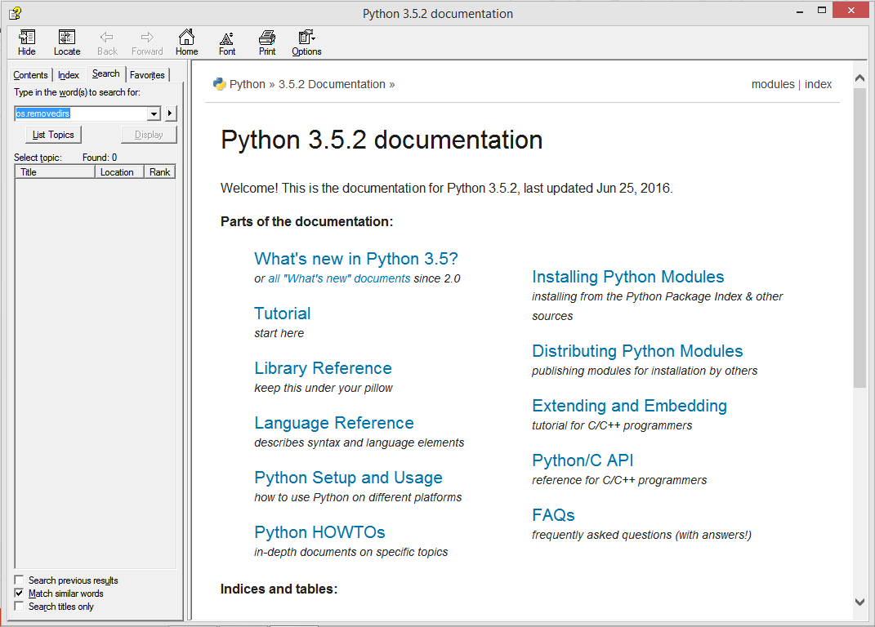
http://docs.python.org/

Slide 17
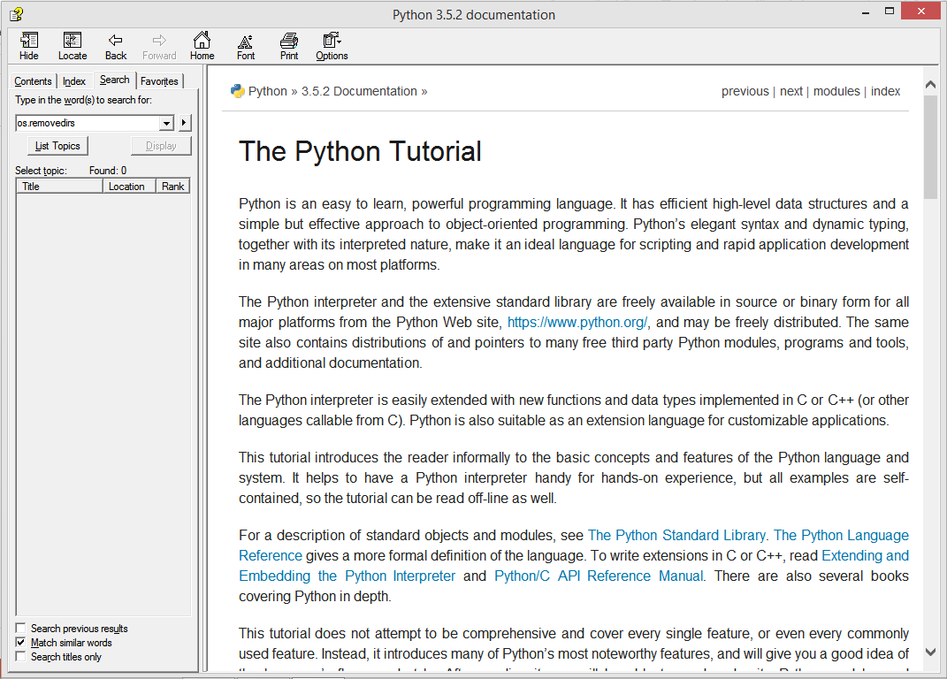
The Python tutorial is Great !

Slide 18
Running Python

Slide 19
The Python Interpreter
Typical Python implementations offer both interactive and scripted behaviour
Interactive interface to Python with a read-evaluate-print loop
C:\Users\Achint> python
Python 3.5.2 (v3.5.2:4def2a2901a5, Jun 25 2016, 22:18:55) [MSC v.1900 64 bit (AMD64)] on win32
Type "help", "copyright", "credits" or "license" for more information.
>>> def square(x):
... return x * x
...
>>> map(square, [1, 2, 3, 4])
[1, 4, 9, 16]
>>>

Slide 20
Installing - Python
Python is pre-installed on most Unix systems, including Linux and MAC OS X
The pre-installed version may not be the most recent one (2.7.14 and 3.6.3 as of Oct 2018)
Download from http://python.org/download/
Python comes with a large library of standard modules
There are several options for an IDE
IDLE – works well with Windows
Emacs with python-mode or your favorite text editor
Eclipse with Pydev (http://pydev.sourceforge.net/)

Slide 21
IDLE Development Environment
IDLE is an Integrated DeveLopment Environ-ment for Python, typically used on Windows
Multi-window text editor with syntax highlighting, auto-completion, smart indent and other.
Python shell with syntax highlighting.
Integrated debugger with stepping, persistent breakpoints, and call stack visibility.

Slide 22
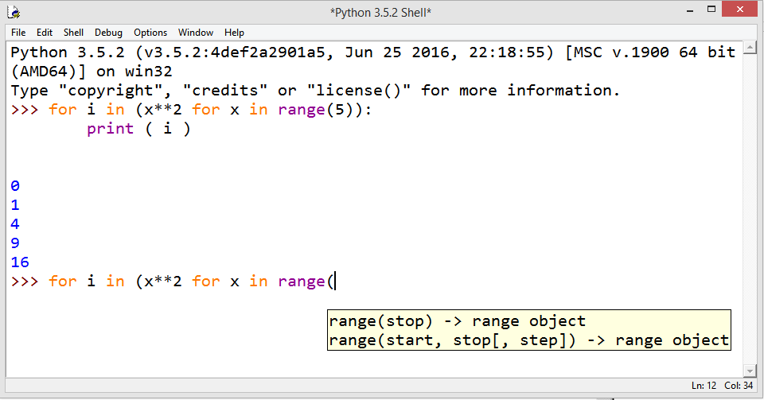
Running Interactively on Windows

Slide 23
Running Interactively on UNIX/Linux
On Unix…
% python
>>> 3+3
6
Python prompts with ‘>>>’.
To exit Python (not Idle):
In Unix, type CONTROL-D
In Windows, type CONTROL-Z + <Enter>
Evaluate exit()

Slide 24
Running Programs on UNIX/Linux
Call python program via the python interpreter
% python fact.py
Make a python file directly executable by
Adding the appropriate path to your python interpreter as the first line of your file
#!/usr/bin/python
Making the file executable
% chmod a+x fact.py
Invoking file from Unix command line
% fact.py

Slide 25
Example ‘script’: fact.py
def fact(x): """Returns the factorial of its argument, assumed to be a posint"""
if x == 0:
return 1
return x * fact(x - 1)
print ( “N fact(N)” )
print ( "---------“ )
for n in range(10):
print ( n, fact(n) )

Slide 26
Python Scripts
When you call a python program from the command line the interpreter evaluates each expression in the file
Familiar mechanisms are used to provide command line arguments and/or redirect input and output
Python also has mechanisms to allow a python program to act both as a script and as a module to be imported and used by another python program

Slide 27
Simple functions: ex.py
"""factorial done recursively and iteratively"""
def fact1(n):
ans = 1
for i in range(2,n):
ans = ans * n
return ans
def fact2(n):
if n < 1:
return 1
else:
return n * fact2(n - 1)

Slide 28
Simple functions: ex.py
>>> python
Python 3.5.2 …
>>> import ex
>>> ex.fact1(6)
1296
>>> ex.fact2(200)
78865786736479050355236321393218507…000000L
>>> ex.fact1
<function fact1 at 0x902470>
>>> fact1
Traceback (most recent call last):
File "<stdin>", line 1, in <module>
NameError: name 'fact1' is not defined

Slide 29
The Basics

Slide 30
PYTHON FEATURES
no compiling or linking | rapid development cycle
no type declarations | simpler, shorter, more flexible
automatic memory management | garbage collection
high-level data types and operations | fast development
object-oriented programming | code structuring and reuse, C++
embedding and extending in C | mixed language systems
classes, modules, exceptions | "programming-in-the-large" support
dynamic loading of C modules | simplified extensions, smaller binaries
dynamic reloading of C modules | programs can be modified without stopping

Slide 31
PYTHON FEATURES (contd.)
universal "first-class" object model | fewer restrictions and rules
run-time program construction | handles unforeseen needs, end-user coding
interactive, dynamic nature | incremental development and testing
access to interpreter information | metaprogramming, introspective objects
wide portability | cross-platform programming without ports
compilation to portable byte-code | execution speed, protecting source code
built-in interfaces to external services | system tools, GUIs, persistence, databases, etc.

Slide 32
A Code Sample (in IDLE)
x = 34 - 23 # A comment.
y = “Hello” # Another one.
z = 3.45
if z == 3.45 or y == “Hello”:
x = x + 1
y = y + “ World” # String concat.
print (x)
print (y)

Slide 33
Enough to Understand the Code
Indented Blocks
Dynamic Declaration & Type detection
Assignment is = and comparison is ==
For numbers + - * / % are as expected
Special use of + for string concatenation and % for string formatting (as in C’s printf)
Logical operators are words (and, or, not) not symbols
The basic printing fucntion is print()

Slide 34
Whitespace
Whitespace is meaningful in Python: especially indentation and placement of newlines
Use a newline to end a line of code
Use \ when must go to next line prematurely
No braces {} to mark blocks of code, use consistent indentation instead
First line with less indentation is outside of the block
First line with more indentation starts a nested block
Colons start of a new block in many constructs, e.g. function definitions, then clauses

Slide 35
Comments
Start comments with #, rest of line is ignored
Can include a “documentation string” as the first line of a new function or class you define
Development environments, debugger, and other tools use it: it’s good style to include one
def fact(n):
‘‘‘fact(n) assumes n is a positive integer and returns facorial of n.’’’ assert(n>0)
return 1 if n==1 else n*fact(n-1)

Slide 36
Assignment
Binding a variable in Python means setting a name to hold a reference to some object
Assignment creates references, not copies
Names in Python do not have an intrinsic type, objects have types
Python determines the type of the reference automatically based on what data is assigned to it
You create a name the first time it appears on the left side of an assignment expression: x = 3
A reference is deleted via garbage collection after any names bound to it have passed out of scope
Python uses reference semantics (more later)

Slide 37
Naming Rules
Names are case sensitive and cannot start with a number. They can contain letters, numbers, and underscores:
bob Bob _bob _2_bob_ bob_2 BoB
There are some reserved words:
and, assert, break, class, continue, def, del, elif, else, except, exec, finally, for, from, global, if, import, in, is, lambda, not, or, pass, print, raise, return, try, while

Slide 38
Naming conventions
The Python community has these recommend-ed naming conventions
joined_lower for functions, methods and, attributes
joined_lower or ALL_CAPS for constants
StudlyCaps for classes
camelCase only to conform to pre-existing conventions
Attributes: interface, _internal, __private

Slide 39
Assignment
You can assign to multiple names at the same time
>>> x, y = 2, 3
>>> x
2
>>> y
3
This makes it easy to swap values
>>> x, y = y, x
Assignments can be chained
>>> a = b = x = 2

Slide 40
Accessing Non-Existent Name
Accessing a name before it’s been properly created (by placing it on the left side of an assignment), raises an error
>>> y
Traceback (most recent call last):
File "<pyshell#16>", line 1, in -toplevel-
y
NameError: name ‘y' is not defined
>>> y = 3
>>> y
3

Slide 41
Mutability
If a variable can be changed in place
Immutable data can’t be changed, a separate copy can be created & previous can be discarded using Garbage collector

Slide 42
In-Built Data Types
What is a variable, what is value of a variable?
Python offers around 8 In-Builts datatypes:
Int (limitless) 6. Dictionary
Float 7. Set
String 8.Frozen_set
Tuple
List

Slide 43
Numeric Types: Integer & Float

Slide 44
Numeric ( Integer & Float )
Integer (default for numbers)
Integers have no upper bound on size, in python, but be careful as your CPU can process few bits (32/64) at a time
Float
Double precision values as in C

Slide 45
Understanding INT
>>> a = 3
>>> type(a)
<class 'int'>
>>> ( a + 2 ) , ( a * 2 ) , ( a / 2 ) , ( a % 3 ) , ( a // 2 )
(5, 6, 1.5, 0, 1)
>>> st = bin(a)
>>> st
'0b11'
>>> int(st,2) , hex(17) , oct(17)
(3, '0x11', '0o21')

Slide 46
Understanding INT (contd.)
>>> int('478',13)
775
>>> a.to_bytes(3,'little')
b'\x03\x00\x00'
>>> a = 1 + 2j
>>> a.real
1.0
>>> a.conjugate()
(1-2j)

Slide 47
Understanding FLOAT
>>> pi = 3.141592654
>>> type(pi)
<class 'float'>
>>> ( pi+2 ) , ( pi*2 ) , ( pi / 2 ) , ( pi % 3 ) , ( pi // 2 )
(5.141592654, 6.283185308, 1.570796327, 0.1415926540000001, 1.0)
>>> pi.is_integer()
False
>>> pi.hex()
'0x1.921fb54524550p+1'
>>> float.fromhex('0x1.921fb54524550p+21')
3294198.658760704
>>> round(pi) , round(pi,4)
(3, 3.1416)

Slide 48
Understanding FLOAT (contd.)
>>> import math
>>>
>>> math.ceil(pi) , math.floor(pi)
(4, 3)
>>>
>>> from fractions import Fraction
>>>
>>> pi.as_integer_ratio()
(442139859559509, 140737488355328)
>>> Fraction(pi)
Fraction(442139859559509, 140737488355328)
>>> Fraction(pi).limit_denominator(100)
Fraction(311, 99)

Slide 49
Sequence types: Tuples, Lists, and Strings

Slide 50
Sequence Types
Tuple: (‘john’, 32, [CMSC])
A simple immutable ordered sequence of items
Items can be of mixed types, including collection types
Strings: “John Smith”
Immutable
Conceptually very much like a tuple
List: [1, 2, ‘john’, (‘up’, ‘down’)]
Mutable ordered sequence of items of mixed types

Slide 51
Similar Syntax
All three sequence types (tuples, strings, and lists) share much of the same syntax and functionality.
Key difference:
Tuples and strings are immutable
Lists are mutable
The operations shown in this section can be applied to all sequence types
most examples will just show the operation performed on one

Slide 52
Sequence Types 1
Define tuples using parentheses and commas
>>> tu = (23, ‘abc’, 4.56, (2,3), ‘def’)
Define lists are using square brackets and commas
>>> li = [“abc”, 34, 4.34, 23]
Define strings using quotes (“, ‘, or “““).
>>> st = “Hello World”
>>> st = ‘Hello World’
>>> st = “““This is a multi-line
string that uses triple quotes.”””

Slide 53
Sequence Types 2
Access individual members of a tuple, list, or string using square bracket “array” notation
Note that all are 0 based…
>>> tu = (23, ‘abc’, 4.56, (2,3), ‘def’)
>>> tu[1] # Second item in the tuple.
‘abc’
>>> li = [“abc”, 34, 4.34, 23]
>>> li[1] # Second item in the list.
34
>>> st = “Hello World”
>>> st[1] # Second character in string.
‘e’

Slide 54
Positive and negative indices
>>> t = (23, ‘abc’, 4.56, (2,3), ‘def’)
Positive index: count from the left, starting with 0
>>> t[1]
‘abc’
Negative index: count from right, starting with –1
>>> t[-3]
4.56

Slide 55
Slicing: return copy of a subset
>>> t = (23, ‘abc’, 4.56, (2,3), ‘def’)
Return a copy of the container with a subset of the original members. Start copying at the first index, and stop copying before fourth.
>>> t[1:4]
(‘abc’, 4.56, (2,3))
Negative indices count from end
>>> t[1:-1]
(‘abc’, 4.56, (2,3))

Slide 56
Slicing: return copy of a subset
>>> t = (23, ‘abc’, 4.56, (2,3), ‘def’)
Omit first index to make copy starting from beginning of the container
>>> t[:2]
(23, ‘abc’)
Omit second index to make copy starting at first index and going to end
>>> t[2:]
(4.56, (2,3), ‘def’)

Slide 57
Copying the Whole Sequence
[ : ] makes a copy of an entire sequence
>>> t[:]
(23, ‘abc’, 4.56, (2,3), ‘def’)
Note the difference between these two lines for mutable sequences
>>> l2 = l1 # Both refer to 1 ref,
# changing one affects both
>>> l2 = l1[:] # Independent copies, two refs

Slide 58
The ‘in’ Operator
Boolean test whether a value is inside a container:
>>> t = [1, 2, 4, 5]
>>> 3 in t
False
>>> 4 in t
True
>>> 4 not in t
False
For strings, tests for substrings
>>> a = 'abcde'
>>> 'c' in a
True
>>> 'cd' in a
True
>>> 'ac' in a
False
Be careful: the in keyword is also used in the syntax of for loops and list comprehensions

Slide 59
The + Operator
The + operator produces a new tuple, list, or string whose value is the concatenation of its arguments.
>>> (1, 2, 3) + (4, 5, 6)
(1, 2, 3, 4, 5, 6)
>>> [1, 2, 3] + [4, 5, 6]
[1, 2, 3, 4, 5, 6]
>>> “Hello” + “ ” + “World”
‘Hello World’

Slide 60
The * Operator
The * operator produces a new tuple, list, or string that “repeats” the original content.
>>> (1, 2, 3) * 3
(1, 2, 3, 1, 2, 3, 1, 2, 3)
>>> [1, 2, 3] * 3
[1, 2, 3, 1, 2, 3, 1, 2, 3]
>>> “Hello” * 3
‘HelloHelloHello’

Slide 61
Mutability: Tuples vs. Lists

Slide 62
Lists are mutable
>>> li = [‘abc’, 23, 4.34, 23]
>>> li[1] = 45
>>> li [‘abc’, 45, 4.34, 23]
We can change lists in place.
Name li still points to the same memory reference when we’re done.

Slide 63
Tuples are immutable
>>> t = (23, ‘abc’, 4.56, (2,3), ‘def’)
>>> t[2] = 3.14
Traceback (most recent call last):
File "<pyshell#75>", line 1, in -toplevel-
tu[2] = 3.14
TypeError: object doesn't support item assignment
You can’t change a tuple.
You can make a fresh tuple and assign its reference to a previously used name.
>>> t = (23, ‘abc’, 3.14, (2,3), ‘def’)
The immutability of tuples means they’re faster than lists.

Slide 64
Operations on Lists Only
>>> li = [1, 11, 3, 4, 5]
>>> li.append(‘a’) # Note the method syntax
>>> li
[1, 11, 3, 4, 5, ‘a’]
>>> li.insert(2, ‘i’)
>>>li
[1, 11, ‘i’, 3, 4, 5, ‘a’]

Slide 65
The extend method vs +
+ creates a fresh list with a new memory ref
extend operates on list li in place.
>>> li.extend([9, 8, 7])
>>> li
[1, 2, ‘i’, 3, 4, 5, ‘a’, 9, 8, 7]
Potentially confusing:
extend takes a list as an argument.
append takes a singleton as an argument.
>>> li.append([10, 11, 12])
>>> li
[1, 2, ‘i’, 3, 4, 5, ‘a’, 9, 8, 7, [10, 11,12]]

Slide 66
Operations on Lists Only
Lists have many methods, including index, count, remove, reverse, sort
>>> li = [‘a’, ‘b’, ‘c’, ‘b’]
>>> li.index(‘b’) # index of 1st occurrence
1
>>> li.count(‘b’) # number of occurrences
2
>>> li.remove(‘b’) # remove 1st occurrence
>>> li
[‘a’, ‘c’, ‘b’]

Slide 67
Operations on Lists Only
>>> li = [5, 2, 6, 8]
>>> li.reverse() # reverse the list *in place*
>>> li
[8, 6, 2, 5]
>>> li.sort() # sort the list *in place*
>>> li
[2, 5, 6, 8]
>>> li.sort(some_function)
# sort in place using user-defined comparison

Slide 68
Tuple details
The comma is the tuple creation operator, not parens
>>> 1,
(1,)
Python shows parens for clarity (best practice)
>>> (1,)
(1,)
Don't forget the comma!
>>> (1)
1
Trailing comma only required for singletons others
Empty tuples have a special syntactic form
>>> ()
()
>>> tuple()
()

Slide 69
Summary: Tuples vs. Lists
Lists slower but more powerful than tuples
Lists can be modified, and they have lots of handy operations and mehtods
Tuples are immutable and have fewer features
To convert between tuples and lists use the list() and tuple() functions:
li = list(tu)
tu = tuple(li)

Slide 70
Module 2 Advanced Data Types & Control Flow

Slide 71
Overview - Mod 2
Set & Frozen Set
Dictionaries
Functions
Logical expressions
Conditional Control Flow
Short Circuiting
Chained conditionals
Nested conditionals
Iterative Control Flow
Comprehensions
More on functions
Assignment and containers
Strings

Slide 72
Set & Frozenset
Frozenset if nothing but, Immutable Set, so what we need is to study set

Slide 73
Analysis of IN operator
>>> import time
>>> def f(seq,val):
init = time.clock()
val in seq
return time.clock()-init
>>> L,S = [ x for x in range(1*10**6) ] , { x for x in range(1*10**6) }
>>> key = 0
>>> t1 , t2 = f(L,key) , f(S,key)
>>> t1 , t2 , t1/t2
(4.462482934286527e-07, 8.924965300138865e-07, 0.5000000318451764)
>>> key = 5*10**5
>>> t1 , t2 = f(L,key) , f(S,key)
>>> t1 , t2 , t1/t2
(0.011422170953210298, 1.7849931168711919e-06, 6398.99999907649)
>>> key = 1*10**6
>>> t1 , t2 = f(L,key) , f(S,key)
>>> t1 , t2 , t1/t2
(0.023676594947119156, 1.7849931168711919e-06, 13264.249998129097)

Slide 74
Dictionaries: A Mapping type
Dictionaries store a mapping between a set of keys and a set of values
Keys can be any immutable type.
Values can be any type
A single dictionary can store values of different types
You can define, modify, view, lookup or delete the key-value pairs in the dictionary
Python’s dictionaries are also known as hash tables and associative arrays

Slide 75
Creating & accessing dictionaries
>>> d = {‘user’:‘bozo’, ‘pswd’:1234}
>>> d[‘user’]
‘bozo’
>>> d[‘pswd’]
123
>>> d[‘bozo’]
Traceback (innermost last):
File ‘<interactive input>’ line 1, in ?
KeyError: bozo

Slide 76
Updating Dictionaries
>>> d = {‘user’:‘bozo’, ‘pswd’:1234}
>>> d[‘user’] = ‘clown’
>>> d
{‘user’:‘clown’, ‘pswd’:1234}
Keys must be unique
Assigning to an existing key replaces its value
>>> d[‘id’] = 45
>>> d
{‘user’:‘clown’, ‘id’:45, ‘pswd’:1234}
Dictionaries are unordered
New entries can appear anywhere in output
Dictionaries work by hashing

Slide 77
Removing dictionary entries
>>> d = {‘user’:‘bozo’, ‘p’:1234, ‘i’:34}
>>> del d[‘user’] # Remove one.
>>> d
{‘p’:1234, ‘i’:34}
>>> d.clear() # Remove all.
>>> d
{}
>>> a=[1,2]
>>> del a[1] # del works on lists, too
>>> a
[1]

Slide 78
Useful Accessor Methods
>>> d = {‘user’:‘bozo’, ‘p’:1234, ‘i’:34}
>>> d.keys() # List of keys, VERY useful
[‘user’, ‘p’, ‘i’]
>>> d.values() # List of values
[‘bozo’, 1234, 34]
>>> d.items() # List of item tuples
[(‘user’,‘bozo’), (‘p’,1234), (‘i’,34)]

Slide 79
A Dictionary Example
Problem: count the frequency of each word in text read from the standard input, print results
Six versions of increasing complexity
wf1.py is a simple start
wf2.py uses a common idiom for default values
wf3.py sorts the output alphabetically
wf4.py downcase and strip punctuation from words and ignore stop words
wf5.py sort output by frequency
wf6.py add command line options: -n, -t, -h

Slide 80
Dictionary example: wf1.py
#!/usr/bin/python
import sys
freq = {} # frequency of words in text
for line in sys.stdin:
for word in line.split():
if word in freq:
freq[word] = 1 + freq[word]
else:
freq[word] = 1
print (freq)

Slide 81
Dictionary example wf1.py
#!/usr/bin/python
import sys
freq = {} # frequency of words in text
for line in sys.stdin:
for word in line.split():
if word in freq:
freq[word] = 1 + freq[word]
else:
freq[word] = 1
print (freq)
This is a common pattern

Slide 82
Dictionary example wf2.py
#!/usr/bin/python
import sys
freq = {} # frequency of words in text
for line in sys.stdin:
for word in line.split():
freq[word] = 1 + freq.get(word,0)
print ( freq )
key
Default value if not found

Slide 83
Dictionary example wf3.py
#!/usr/bin/python
import sys
freq = {} # frequency of words in text
for line in sys.stdin:
for word in line.split():
freq[word] = freq.get(word,0)
for w in sorted(freq.keys()):
print ( w, freq[w] )

Slide 84
Dictionary example wf4.py
#!/usr/bin/python
import sys
from operator import itemgetter
punctuation = """'!"#$%&\'()*+,-./:;<=>?@[\\]^_`{|}~'"""
freq = {} # frequency of words in text
stop_words = {}
for line in open("stop_words.txt"):
stop_words[line.strip()] = True

Slide 85
Dictionary example wf5.py
for line in sys.stdin:
for word in line.split():
word = word.strip(punctuation).lower()
if not word in stop_words:
freq[word] = freq.get(word,0) + 1
words = sorted(freq.iteritems(), key=itemgetter(1), reverse=True)
for w,f in words:
print ( w, f )

Slide 86
Dictionary example wf6.py
from optparse import OptionParser
# read command line arguments and process
parser = OptionParser()
parser.add_option('-n', '--number', type="int", default=-1, help='number of words to report')
parser.add_option("-t", "--threshold", type="int", default=0, help=”print if frequency > threshold")
(options, args) = parser.parse_args()
...
# print the top option.number words but only those
# with freq>option.threshold
for (word, freq) in words[:options.number]:
if freq > options.threshold:
print ( freq, word )

Slide 87
Why must keys be immutable?
The keys used in a dictionary must be immutable objects?
>>> name1, name2 = 'john', ['bob', 'marley']
>>> fav = name2
>>> d = {name1: 'alive', name2: 'dead'}
Traceback (most recent call last):
File "<stdin>", line 1, in <module>
TypeError: list objects are unhashable
Why so? Suppose we could index a value for name2
and then did fav[0] = “Bobby”
Could we find d[name2] or d[fav] or …?

Slide 88
Functions in Python

Slide 89
Defining Functions
Function definition begins with “def.”
Function name and its arguments.
def get_final_answer(filename):
“““Documentation String””” line1
line2
return total_counter
Colon.
The indentation matters…
First line with less indentation is considered to be outside of the function definition.
The keyword ‘return’ indicates the value to be sent back to the caller.
No header file or declaration of types of function or arguments

Slide 90
Python and Types
Dynamic typing: Python determines the data types of variable bindings in a program automatically
Strong typing: But Python’s not casual about types, it enforces the types of objects
For example, you can’t just append an integer to a string, but must first convert it to a string
x = “the answer is ” # x bound to a string
y = 23 # y bound to an integer.
print ( x + y ) # Python will complain!

Slide 91
Calling a Function
The syntax for a function call is:
>>> def myfun(x, y):
return x * y
>>> myfun(3, 4)
12
Parameters in Python are Call by Assignment
Old values for the variables that are parameter names are hidden, and these variables are simply made to refer to the new values
All assignment in Python, including binding function parameters, uses reference semantics.

Slide 92
Functions without returns
All functions in Python have a return value, even if no return line inside the code
Functions without a return return the special value None
None is a special constant in the language
None is used like NULL, void, or nil in other languages
None is also logically equivalent to False
The interpreter doesn’t print None

Slide 93
Function overloading? No.
There is no function overloading in Python
Unlike C++, a Python function is specified by its name alone
The number, order, names, or types of its arguments cannot be used to distinguish between two functions with the same name
Two different functions can’t have the same name, even if they have different arguments
But: see operator overloading in later slides

Slide 94
Default Values for Arguments
You can provide default values for a function’s arguments
These arguments are optional when the function is called
>>> def myfun(b, c=3, d=“hello”): return b + c
>>> myfun(5,3,”hello”)
>>> myfun(5,3)
>>> myfun(5)
All of the above function calls return 8

Slide 95
Keyword Arguments
You can call a function with some or all of its arguments out of order as long as you specify their names
You can also just use keywords for a final subset of the arguments.
>>> def myfun(a, b, c): return a-b
>>> myfun(2, 1, 43)
1
>>> myfun(c=43, b=1, a=2)
1
>>> myfun(2, c=43, b=1)
1

Slide 96
Functions are first-class objects
Functions can be used as any other datatype, eg:
Arguments to function
Return values of functions
Assigned to variables
Parts of tuples, lists, etc
>>> def square(x):
return x*x
>>> def applier(q, x):
return q(x)
>>> applier(square, 7)
49

Slide 97
Lambda Notation
Python uses a lambda notation to create anonymous functions
>>> applier(lambda z: z * 4, 7)
28
Python supports functional programming idioms, including closures and continuations

Slide 98
Lambda Notation
Be careful with the syntax
>>> f = lambda x,y : 2 * x + y
>>> f
<function <lambda> at 0x87d30>
>>> f(3, 4)
10
>>> v = lambda x: x*x(100)
>>> v
<function <lambda> at 0x87df0>
>>> v = (lambda x: x*x)(100)
>>> v
10000

Slide 99
Example: composition
>>> def square(x):
return x*x
>>> def twice(f):
return lambda x: f(f(x))
>>> twice
<function twice at 0x87db0>
>>> quad = twice(square)
>>> quad
<function <lambda> at 0x87d30>
>>> quad(5)
625

Slide 100
Example: closure
>>> def counter(start=0, step=1):
x = [start]
def _inc():
x[0] += step
return x[0]
return _inc
>>> c1 = counter()
>>> c2 = counter(100, -10)
>>> c1()
1
>>> c2()
90

Slide 101
Logical Expressions

Slide 102
True and False
True and False are constants in Python.
Other values equivalent to True and False:
False: zero, None, empty container or object
True: non-zero numbers, non-empty objects
Comparison operators: ==, !=, <, <=,…
X and Y have same value: X == Y
Compare with X is Y :
X and Y are two variables that refer to the identical same object.

Slide 103
Boolean Logic Expressions
You can also combine Boolean expressions.
True if a is True and b is True: a and b
True if a is True or b is True: a or b
True if a is False: not a
Use parentheses as needed to disambiguate complex Boolean expressions.

Slide 104
Special Properties of and & or
Actually and and or don’t return True or False but value of one of their sub-expressions, which may be a non-Boolean value
X and Y and Z
If all are true, returns value of Z
Otherwise, returns value of first false sub-expression
X or Y or Z
If all are false, returns value of Z
Otherwise, returns value of first true sub-expression
And and or use lazy evaluation, so no further expressions are evaluated

Slide 105
The “and-or” Trick
An old deprecated trick to implement a simple conditional result = test and expr1 or expr2
When test is True, result is assigned expr1
When test is False, result is assigned expr2
Works almost like C++’s (test ? expr1 : expr2)
But if the value of expr1 is ever False, the trick doesn’t work
Don’t use it; made unnecessary by conditional expressions in Python 2.5 (see next slide)

Slide 106
Conditional Expressions in Python 2.5
x = true_value if condition else false_value
Uses lazy evaluation:
First, condition is evaluated
If True, true_value is evaluated and returned
If False, false_value is evaluated and returned
Standard use:
x = (true_value if condition else false_value)

Slide 107
Control of Flow

Slide 108
if Statements
if x == 3:
print ( “X equals 3.” )
elif x == 2:
print ( “X equals 2.” )
else:
print ( “X equals something else.” )
print ( “This is outside the ‘if’.” )
Be careful! The keyword if is also used in the syntax of filtered list comprehensions. Note:
Use of indentation for blocks
Colon (:) after boolean expression

Slide 109
while Loops
>>> x = 3
>>> while x < 5:
print ( x, “still in the loop” )
x = x + 1
3 still in the loop
4 still in the loop
>>> x = 6
>>> while x < 5:
print ( x, "still in the loop“ )
>>>

Slide 110
break and continue
You can use the keyword break inside a loop to leave the while loop entirely.
You can use the keyword continue inside a loop to stop processing the current iteration of the loop and to immediately go on to the next one.

Slide 111
assert
An assert statement will check to make sure that something is true during the course of a program.
If the condition if false, the program stops
(more accurately: the program throws an exception)
assert(number_of_players < 5)

Slide 112
List Comprehensions

Slide 113
Python’s higher-order functions
Python supports higher-order functions that operate on lists similar to Scheme’s
>>> def square(x):
return x*x
>>> def even(x):
return 0 == x % 2
>>> map(square, range(10,20))
[100, 121, 144, 169, 196, 225, 256, 289, 324, 361]
>>> filter(even, range(10,20))
[10, 12, 14, 16, 18]
>>> map(square, filter(even, range(10,20)))
[100, 144, 196, 256, 324]
But many Python programmers prefer to use list comprehensions, instead

Slide 114
List Comprehensions
A list comprehension is a programming language construct for creating a list based on existing lists
Haskell, Erlang, Scala and Python have them
Why “comprehension”? The term is borrowed from math’s set comprehension notation for defining sets in terms of other sets
A powerful and popular feature in Python
Generate a new list by applying a function to every member of an original list
Python’s notation: [ expression for name in list ]

Slide 115
List Comprehensions
The syntax of a list comprehension is somewhat tricky
[x-10 for x in grades if x>0]
Syntax suggests that of a for-loop, an in operation, or an if statement
All three of these keywords (‘for’, ‘in’, and ‘if’) are also used in the syntax of forms of list comprehensions
[ expression for name in list ]

Slide 116
List Comprehensions
Note: Non-standard colors on next few slides clarify the list comprehension syntax.
>>> li = [3, 6, 2, 7]
>>> [elem*2 for elem in li]
[6, 12, 4, 14]
[ expression for name in list ]
Where expression is some calculation or operation acting upon the variable name.
For each member of the list, the list comprehension
sets name equal to that member,
calculates a new value using expression,
It then collects these new values into a list which is the return value of the list comprehension.
[ expression for name in list ]

Slide 117
List Comprehensions
If list contains elements of different types, then expression must operate correctly on the types of all of list members.
If the elements of list are other containers, then the name can consist of a container of names that match the type and “shape” of the list members.
>>> li = [(‘a’, 1), (‘b’, 2), (‘c’, 7)]
>>> [ n * 3 for (x, n) in li]
[3, 6, 21]
[ expression for name in list ]

Slide 118
List Comprehensions
expression can also contain user-defined functions.
>>> def subtract(a, b): return a – b
>>> oplist = [(6, 3), (1, 7), (5, 5)]
>>> [subtract(y, x) for (x, y) in oplist]
[-3, 6, 0]
[ expression for name in list ]

Slide 119
Syntactic sugar
List comprehensions can be viewed as syntactic sugar for a typical higher-order functions
[ expression for name in list ]
map( lambda name: expression, list )
[ 2*x+1 for x in [10, 20, 30] ]
map( lambda x: 2*x+1, [10, 20, 30] )

Slide 120
Filtered List Comprehension
Filter determines whether expression is performed on each member of the list.
For each element of list, checks if it satisfies the filter condition.
If the filter condition returns False, that element is omitted from the list before the list comprehension is evaluated.
[ expression for name in list if filter]

Slide 121
Filtered List Comprehension
>>> li = [3, 6, 2, 7, 1, 9]
>>> [elem*2 for elem in li if elem > 4]
[12, 14, 18]
Only 6, 7, and 9 satisfy the filter condition
So, only 12, 14, and 18 are produce.
[ expression for name in list if filter]

Slide 122
More syntactic sugar
Including an if clause begins to show the benefits of the sweetened form
[ expression for name in list if filt ]
map( lambda name . expression, filter(filt, list) )
[ 2*x+1 for x in [10, 20, 30] if x > 0 ]
map( lambda x: 2*x+1,
filter( lambda x: x > 0 , [10, 20, 30] )

Slide 123
Nested List Comprehensions
Since list comprehensions take a list as input and produce a list as output, they are easily nested
>>> li = [3, 2, 4, 1]
>>> [elem*2 for elem in [item+1 for item in li] ]
[8, 6, 10, 4]
The inner comprehension produces: [4, 3, 5, 2]
So, the outer one produces: [8, 6, 10, 4]
[ expression for name in list ]

Slide 124
Syntactic sugar
[ e1 for n1 in [ e1 for n1 list ] ]
map( lambda n1: e1,
map( lambda n2: e2, list ) )
[2*x+1 for x in [y*y for y in [10, 20, 30] ] ]
map( lambda x: 2*x+1,
map( lambda y: y*y, [10, 20, 30] ) )

Slide 125
For Loops

Slide 126
For Loops / List Comprehensions
Python’s list comprehensions provide a natural idiom that usually requires a for-loop in other programming languages.
As a result, Python code uses many fewer for-loops
Nevertheless, it’s important to learn about for-loops.
Take care! The keywords for and in are also used in the syntax of list comprehensions, but this is a totally different construction.

Slide 127
For Loops 1
A for-loop steps through each of the items in a collection type, or any other type of object which is “iterable”
for <item> in <collection>: <statements>
If <collection> is a list or a tuple, then the loop steps through each element of the sequence
If <collection> is a string, then the loop steps through each character of the string
for someChar in “Hello World”:
print ( someChar )

Slide 128
For Loops 2
for <item> in <collection>: <statements>
<item> can be more than a single variable name
When the <collection> elements are themselves sequences, then <item> can match the structure of the elements.
This multiple assignment can make it easier to access the individual parts of each element
for (x,y) in [(a,1),(b,2),(c,3),(d,4)]:
print ( x )

Slide 129
For loops & the range() function
Since a variable often ranges over some sequence of numbers, the range() function returns a list of numbers from 0 up to but not including the number we pass to it.
range(5) returns [0,1,2,3,4]
So we could say: for x in range(5): print ( x )
(There are more complex forms of range() that provide richer functionality…)

Slide 130
For Loops and Dictionaries
>>> ages = { "Sam" : 4, "Mary" : 3, "Bill" : 2 }
>>> ages
{'Bill': 2, 'Mary': 3, 'Sam': 4}
>>> for name in ages.keys():
print ( name, ages[name] )
Bill 2
Mary 3
Sam 4
>>>

Slide 131
Assignment and Containers

Slide 132
Multiple Assignment with Sequences
We’ve seen multiple assignment before:
>>> x, y = 2, 3
But you can also do it with sequences.
The type and “shape” just has to match.
>>> (x, y, (w, z)) = (2, 3, (4, 5))
>>> [x, y] = [4, 5]

Slide 133
Empty Containers 1
Assignment creates a name, if it didn’t exist already.
x = 3 Creates name x of type integer.
Assignment is also what creates named references to containers.
>>> d = {‘a’:3, ‘b’:4}
We can also create empty containers:
>>> li = []
>>> tu = ()
>>> di = {}
These three are empty, but of different types
Note: an empty container is logically equivalent to False. (Just like None.)

Slide 134
Empty Containers 2
Why create a named reference to empty container?
To initialize an empty list
This would cause an unknown name error if a named reference to the right data type wasn’t created first
>>> g.append(3)
Python complains here about the unknown name ‘g’!
>>> g = []
>>> g.append(3)
>>> g [3]

Slide 135
String Operations

Slide 136
String Operations
A number of methods for the string class perform useful formatting operations:
>>> “hello”.upper()
‘HELLO’
Check the Python documentation for many other handy string operations.
Helpful hint: use <string>.strip() to strip off final newlines from lines read from files

Slide 137
String Formatting Operator: %
The operator % allows strings to be built out of many data items a la “fill in the blanks”
Allows control of how the final output appears
For example, we could force a number to display with a specific number of digits after the decimal point
Very similar to the sprintf command of C.
>>> x = “abc”
>>> y = 34
>>> “%s xyz %d” % (x, y)
‘abc xyz 34’
The tuple following the % operator used to fill in blanks in original string marked with %s or %d.

Slide 138
Printing with Python
You can print a string to the screen using print
Using the % operator in combination with print, we can format our output text
>>> print ( “%s xyz %d” % (“abc”, 34))
abc xyz 34
Print adds a newline to the end of the string. If you include a list of strings, it will concatenate them with a space between them
>>> print ( “abc” ) >>> print ( “abc”, “def” )
abc abc def
Useful trick: >>> print ( “abc” ), doesn’t add newline just a single space

Slide 139
String Conversions

Slide 140
Join and Split
Join turns a list of strings into one string <separator_string>.join( <some_list> )
>>> “;”.join( [“abc”, “def”, “ghi”] )
“abc;def;ghi”
Split turns one string into a list of strings <some_string>.split( <separator_string> )
>>> “abc;def;ghi”.split( “;” )
[“abc”, “def”, “ghi”]

Slide 141
Split & Join with List Comprehensions
Split and join can be used in a list compre-hension in the following Python idiom:
>>> " ".join( [s.capitalize() for s in "this is a test ".split( )] )
'This Is A Test‘
>>> # For clarification:
>>> "this is a test" .split( )
['this', 'is', 'a', 'test']
>>> [s.capitalize() for s in "this is a test" .split()]
['This', 'Is', 'A', 'Test’]

Slide 142
Convert Anything to a String
The builtin str() function can convert an instance of any data type into a string.
You define how this function behaves for user-created data types
You can also redefine the behavior of this function for many types.
>>> “Hello ” + str(2)
“Hello 2”

Slide 143
Module 3

Slide 144
Importing and Modules

Slide 145
Importing and Modules
Use classes & functions defined in another file
A Python module is a file with the same name (plus the .py extension)
Like Java import, C++ include
Three formats of the command:
import somefile
from somefile import *
from somefile import className
The difference? What gets imported from the file and what name refers to it after importing

Slide 146
import …
import somefile
Everything in somefile.py gets imported.
To refer to something in the file, append the text “somefile.” to the front of its name:
somefile.className.method(“abc”)
somefile.myFunction(34)

Slide 147
from … import *
from somefile import *
Everything in somefile.py gets imported
To refer to anything in the module, just use its name. Everything in the module is now in the current namespace.
Take care! Using this import command can easily overwrite the definition of an existing function or variable!
className.method(“abc”)
myFunction(34)

Slide 148
from … import …
from somefile import className
Only the item className in somefile.py gets imported.
After importing className, you can just use it without a module prefix. It’s brought into the current namespace.
Take care! Overwrites the definition of this name if already defined in the current namespace!
className.method(“abc”) ⬅ imported
myFunction(34) ⬅ Not imported

Slide 149
Directories for module files
Where does Python look for module files?
The list of directories where Python will look for the files to be imported is sys.path
This is just a variable named ‘path’ stored inside the ‘sys’ module
>>> import sys
>>> sys.path
['', '/Library/Frameworks/Python.framework/Versions/2.5/lib/python2.5/site-packages/setuptools-0.6c5-py2.5.egg’, …]
To add a directory of your own to this list, append it to this list
sys.path.append(‘/my/new/path’)

Slide 150
Object Oriented Programming in Python: Defining Classes

Slide 151
It’s all objects…
Everything in Python is really an object.
We’ve seen hints of this already… “hello”.upper() list3.append(‘a’) dict2.keys()
These look like Java or C++ method calls.
New object classes can easily be defined in addition to these built-in data-types.
In fact, programming in Python is typically done in an object oriented fashion.

Slide 152
Defining a Class
A class is a special data type which defines how to build a certain kind of object.
The class also stores some data items that are shared by all the instances of this class
Instances are objects that are created which follow the definition given inside of the class
Python doesn’t use separate class interface definitions as in some languages
You just define the class and then use it

Slide 153
Methods in Classes
Define a method in a class by including function definitions within the scope of the class block
There must be a special first argument self in all of method definitions which gets bound to the calling instance
There is usually a special method called __init__ in most classes
We’ll talk about both later…

Slide 154
A simple class def: student
class student: “““A class representing a student ””” def __init__(self,n,a): self.full_name = n self.age = a def get_age(self): return self.age

Slide 155
Creating and Deleting Instances

Slide 156
Instantiating Objects
There is no “new” keyword as in Java.
Just use the class name with ( ) notation and assign the result to a variable
__init__ serves as a constructor for the class. Usually does some initialization work
The arguments passed to the class name are given to its __init__() method
So, the __init__ method for student is passed “Bob” and 21 and the new class instance is bound to b:
b = student(“Bob”, 21)

Slide 157
Constructor: __init__
An __init__ method can take any number of arguments.
Like other functions or methods, the arguments can be defined with default values, making them optional to the caller.
However, the first argument self in the definition of __init__ is special…

Slide 158
Self
The first argument of every method is a reference to the current instance of the class
By convention, we name this argument self
In __init__, self refers to the object currently being created; so, in other class methods, it refers to the instance whose method was called
Similar to the keyword this in Java or C++
But Python uses self more often than Java uses this

Slide 159
Self
Although you must specify self explicitly when defining the method, you don’t include it when calling the method.
Python passes it for you automatically
Defining a method: Calling a method:
(this code inside a class definition.)
def set_age(self, num): >>> x.set_age(23) self.age = num

Slide 160
Deleting instances: No Need to “free”
When you are done with an object, you don’t have to delete or free it explicitly.
Python has automatic garbage collection.
Python will automatically detect when all of the references to a piece of memory have gone out of scope. Automatically frees that memory.
Generally works well, few memory leaks
There’s also no “destructor” method for classes

Slide 161
Access to Attributes and Methods

Slide 162
Definition of student
class student: “““A class representing a student ””” def __init__(self,n,a): self.full_name = n self.age = a def get_age(self): return self.age

Slide 163
Traditional Syntax for Access
>>> f = student(“Bob Smith”, 23)
>>> f.full_name # Access attribute
“Bob Smith”
>>> f.get_age() # Access a method
23

Slide 164
Accessing unknown members
Problem: Occasionally the name of an attribute or method of a class is only given at run time…
Solution:
getattr(object_instance, string)
string is a string which contains the name of an attribute or method of a class
getattr(object_instance, string) returns a reference to that attribute or method

Slide 165
getattr(object_instance, string)
>>> f = student(“Bob Smith”, 23)
>>> getattr(f, “full_name”)
“Bob Smith”
>>> getattr(f, “get_age”)
<method get_age of class studentClass at 010B3C2>
>>> getattr(f, “get_age”)() # call it
23
>>> getattr(f, “get_birthday”)
# Raises AttributeError – No method!

Slide 166
hasattr(object_instance,string)
>>> f = student(“Bob Smith”, 23)
>>> hasattr(f, “full_name”)
True
>>> hasattr(f, “get_age”)
True
>>> hasattr(f, “get_birthday”)
False

Slide 167
Attributes

Slide 168
Two Kinds of Attributes
The non-method data stored by objects are called attributes
Data attributes
Variable owned by a particular instance of a class
Each instance has its own value for it
These are the most common kind of attribute
Class attributes
Owned by the class as a whole
All class instances share the same value for it
Called “static” variables in some languages
Good for (1) class-wide constants and (2) building counter of how many instances of the class have been made

Slide 169
Data Attributes
Data attributes are created and initialized by an __init__() method.
Simply assigning to a name creates the attribute
Inside the class, refer to data attributes using self
for example, self.full_name
class teacher: “A class representing teachers.” def __init__(self,n): self.full_name = n def print_name(self): print ( self.full_name )

Slide 170
Class Attributes
Because all instances of a class share one copy of a class attribute, when any instance changes it, the value is changed for all instances
Class attributes are defined within a class definition and outside of any method
Since there is one of these attributes per class and not one per instance, they’re accessed via a different notation:
Access class attributes using self.__class__.name notation -- This is just one way to do this & the safest in general.
class sample: >>> a = sample() x = 23 >>> a.increment() def increment(self): >>> a.__class__.x self.__class__.x += 1 24

Slide 171
Data vs. Class Attributes
class counter: overall_total = 0 # class attribute def __init__(self): self.my_total = 0 # data attribute def increment(self): counter.overall_total = \ counter.overall_total + 1 self.my_total = \ self.my_total + 1
>>> a = counter() >>> b = counter() >>> a.increment() >>> b.increment() >>> b.increment() >>> a.my_total 1 >>> a.__class__.overall_total 3 >>> b.my_total 2 >>> b.__class__.overall_total 3

Slide 172
Inheritance

Slide 173
Subclasses
A class can extend the definition of another class
Allows use (or extension ) of methods and attributes already defined in the previous one.
New class: subclass. Original: parent, ancestor or superclass
To define a subclass, put the name of the superclass in parentheses after the subclass’s name on the first line of the definition. Class Cs_student(student):
Python has no ‘extends’ keyword like Java.
Multiple inheritance is supported.

Slide 174
Redefining Methods
To redefine a method of the parent class, include a new definition using the same name in the subclass.
The old code won’t get executed.
To execute the method in the parent class in addition to new code for some method, explicitly call the parent’s version of the method.
parentClass.methodName(self, a, b, c)
The only time you ever explicitly pass ‘self’ as an argument is when calling a method of an ancestor.

Slide 175
Definition of a class extending student
Class Student: “A class representing a student.”
def __init__(self,n,a): self.full_name = n self.age = a
def get_age(self): return self.age
Class Cs_student (student): “A class extending student.” def __init__(self,n,a,s): student.__init__(self,n,a) #Call __init__ for student
self.section_num = s
def get_age(): #Redefines get_age method entirely print ( “Age: ” + str(self.age) )

Slide 176
Extending __init__
Same as for redefining any other method…
Commonly, the ancestor’s __init__ method is executed in addition to new commands.
You’ll often see something like this in the __init__ method of subclasses:
parentClass.__init__(self, x, y) where parentClass is the name of the parent’s class.

Slide 177
Special Built-In Methods and Attributes

Slide 178
Built-In Members of Classes
Classes contain many methods and attributes that are included by Python even if you don’t define them explicitly.
Most of these methods define automatic functionality triggered by special operators or usage of that class.
The built-in attributes define information that must be stored for all classes.
All built-in members have double underscores around their names: __init__ __doc__

Slide 179
Special Methods
For example, the method __repr__ exists for all classes, and you can always redefine it
The definition of this method specifies how to turn an instance of the class into a string
print f sometimes calls f.__repr__() to produce a string for object f
If you type f at the prompt and hit ENTER, then you are also calling __repr__ to determine what to display to the user as output

Slide 180
Special Methods – Example
class student: ... def __repr__(self): return “I’m named ” + self.full_name ...
>>> f = student(“Bob Smith”, 23)
>>> print ( f )
I’m named Bob Smith
>>> f
“I’m named Bob Smith”

Slide 181
Special Methods
You can redefine these as well:
__init__ : The constructor for the class
__cmp__ : Define how == works for class
__len__ : Define how len( obj ) works
__copy__ : Define how to copy a class
Other built-in methods allow you to give a class the ability to use [ ] notation like an array or ( ) notation like a function call

Slide 182
Special Data Items
These attributes exist for all classes.
__doc__ : Variable for documentation string for class
__class__ : Variable which gives you a reference to the class from any instance of it
__module__ : Variable which gives a reference to the module in which the particular class is defined
__dict__ :The dictionary that is actually the namespace for a class (but not its superclasses)
Useful:
dir(x) returns a list of all methods and attributes defined for object x

Slide 183
Special Data Items – Example
>>> f = student(“Bob Smith”, 23)
>>> print ( f.__doc__ )
A class representing a student.
>>> f.__class__
< class studentClass at 010B4C6 >
>>> g = f.__class__(“Tom Jones”, 34)

Slide 184
Private Data and Methods
Any attribute/method with 2 leading under-scores in its name (but none at the end) is private and can’t be accessed outside of class
Note: Names with two underscores at the beginning and the end are for built-in methods or attributes for the class
Note: There is no ‘protected’ status in Python; so, subclasses would be unable to access these private data either.

